Slide 1
Foundation Course
S.Y.B.Com Semester III
(Contemporary Issues)
Neha Patange
Ref: - Michael Vaz, Arrora Vaz, Foundation Course –III, Manan Prakashan
www.google.com

Slide 2
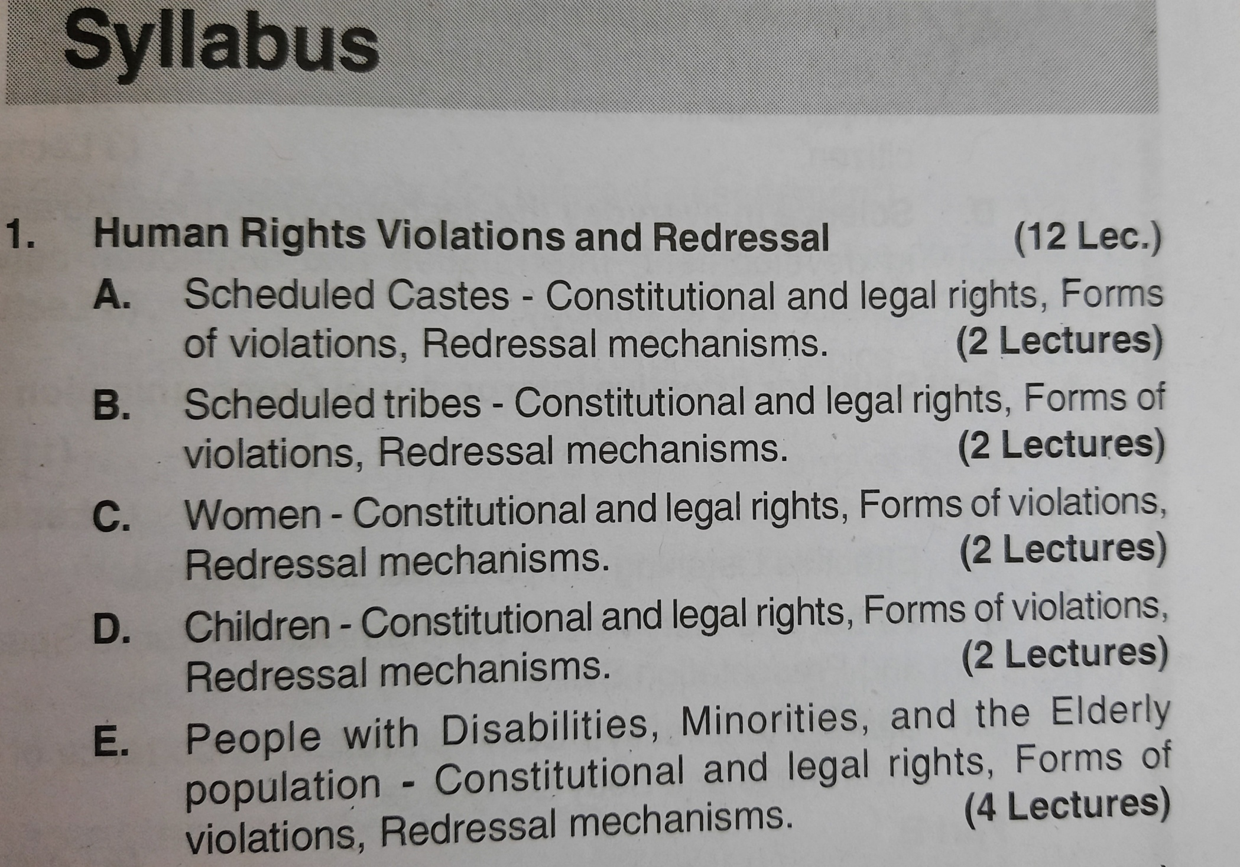

Slide 3
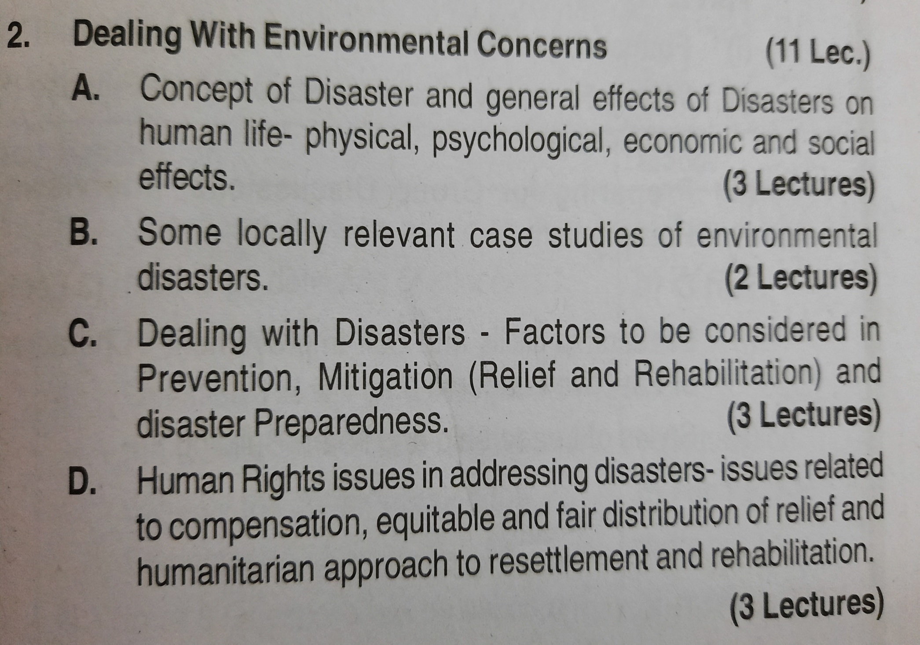

Slide 4
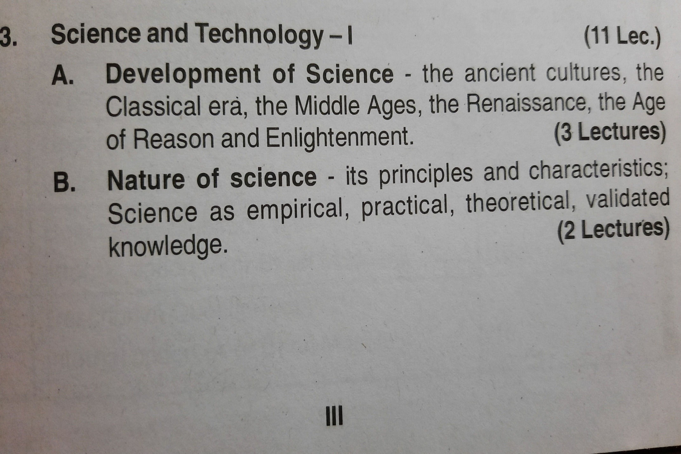

Slide 5
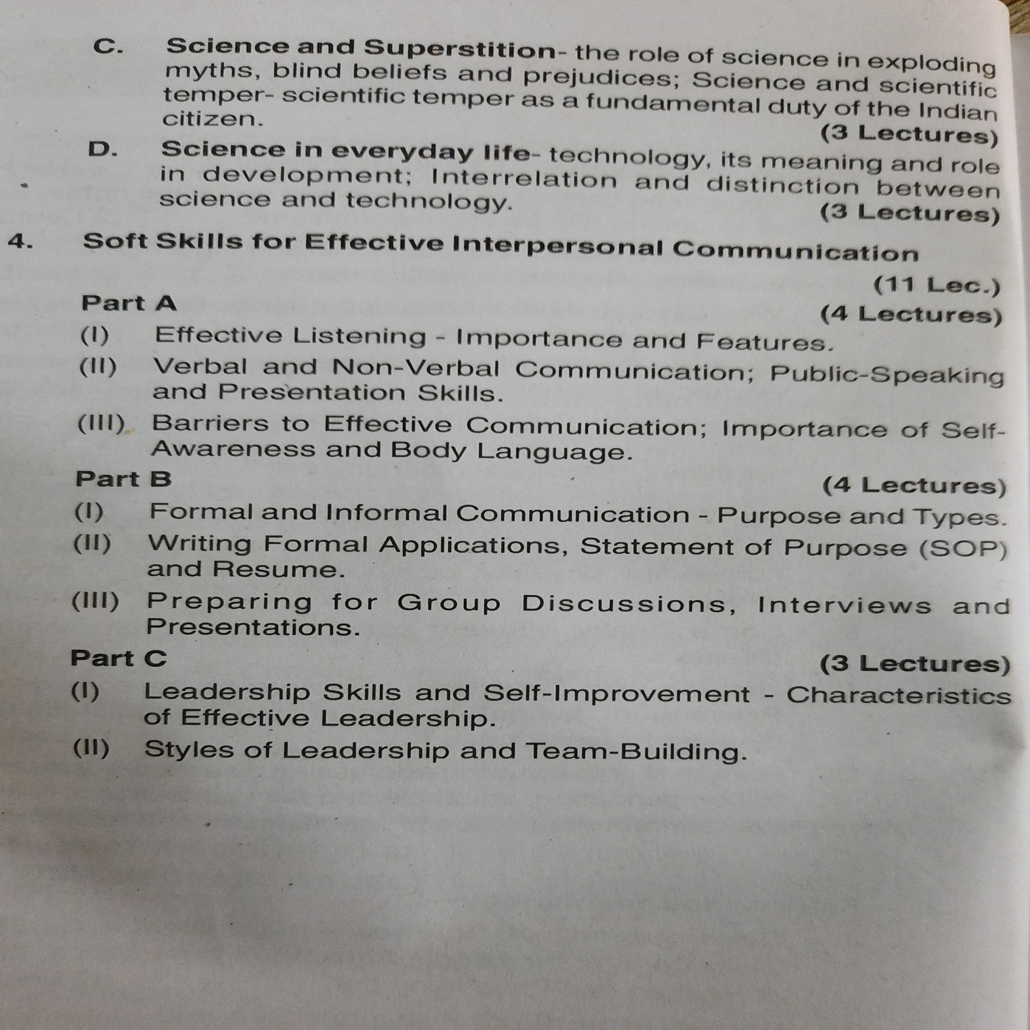

Slide 6
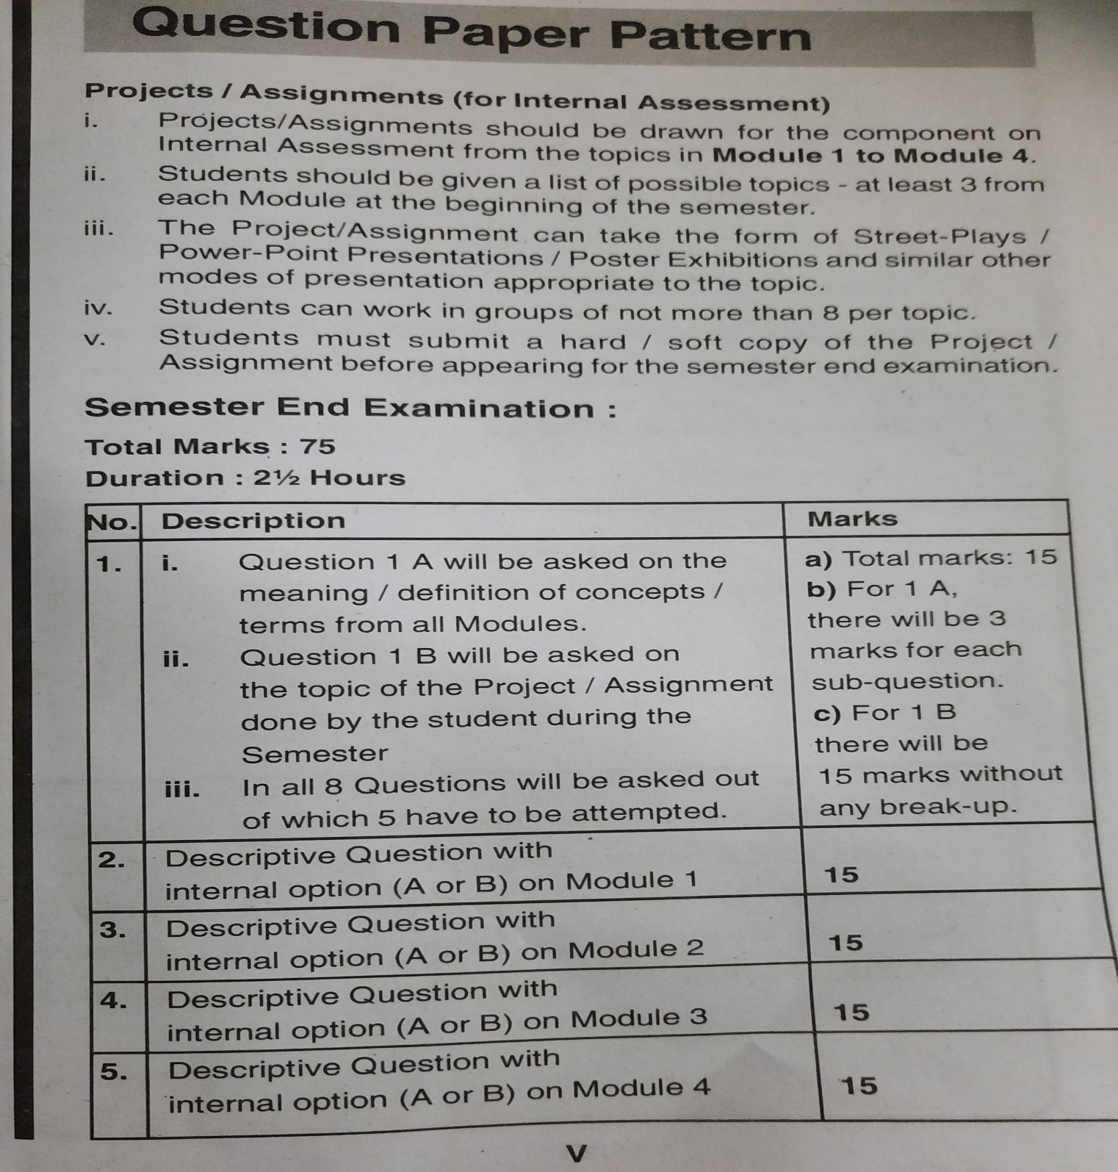

Slide 7
Human Rights Provisions, Violations & Redressal
Scheduled Castes
Scheduled Tribes
Women
Children
People with Disabilities
Minorities
Elderly People

Slide 8
Introduction
Human rights are rights inherent to all human beings, regardless of race, gender, nationality, ethnicity, language, religion, or any other status. Human rights include the right to life and liberty, freedom from slavery and torture, freedom of opinion and expression, the right to work and education, and many more. Everyone is entitled to these rights, without discrimination.
Ref: Michael Vaz, Arrora Vaz, Foundation Course –III, Manan Prakashan

Slide 9
The Universal Declaration of Human Rights (UDHR 1948) defines “Human Rights” as “rights derived from the inherent dignity of human”

Slide 10
Human Rights are
Fundamental Rights
Political Rights
Economic and Social Rights

Slide 11
VIOLATION OF RIGHTS OF VULNERABLE GROUPS
Vulnerable groups are sections of society that experience economic & social backwardness and other forms of social exclusion as compared to the general population.
It includes women, children, elderly disabled, migrants, linguistic and religious minorities, scheduled castes and scheduled tribes.
Violations are as follows:
1. Discrimination- Unequal treatment to different kinds of people on the grounds of race, religion, caste, age , gender, economic status.
Even girls are given unjust treatment as compared to boys in terms of facilities, education etc.
2. Deprivation- It refers to lack of basic resources and facilities such as food, clothing,shelter etc.

Slide 12
3. Exploitation- It is an action of treating someone unfairly to get benefit from their work. Some groups in the society take undue advantage of weaker sections in the society. Uneducated weaker sections get exploited by landlords, money lenders and others.
4. Neglect- It is a lack of care and attention to certain weaker sections of the society. Elderly persons are neglected in terms of health care and other facilities.
5. Violence- It involves behavior involving physical force intended to hurt, damage or destroy or kill someone or something.

Slide 13
Meaning of Scheduled Castes
Article 341 and 342 of the constitution of India have reference to SCs and STs with respect to any state or Union territory.
They are the backward class of citizens disadvantaged people in India.
SCs belong to religions- Hinduism, Neo- Buddhism and Sikhs.
- Foundation course III, Manan Prakashan, Michael Vaz, Aurora Vaz, 2019.

Slide 14
Violations of rights of Scheduled Caste
Untouchability and other crimes:
Untouchability has been a major crime practiced for generations together against the lower caste. There has always been a depiction of untouchability related crimes in the media and the government of India has taken several measures to combat these sectarian crimes against the lowest in the social strata.
Poverty:
Along with Untouchability comes the issue of poverty which is the most prominently held fear of the lower castes in the India society. They are denied access to landholdings and all attempts made to undermine poverty is defeated in the long run. There have been attempts to bring the scheduled caste in the mainstream .However, the success has been limited.
Economic Exploitation:
Further, the main issue that the people in this group face is economic exploitation on account of illiteracy , landlessness and poverty. Attempts to alleviate their status were made by social reformers in various parts of India.

Slide 15
Continued
Bonded Labour:
It means forcing SCs to work as a begar or other forms of forced labour. Most laborers are low caste, illiterate, extremely poor while employers are higher caste,literate, wealthy and more powerful members of the society.
Discrimination at school:
Children of SCs were forced to sit at a distance from upper caste students. There was a lack of attention towards their education. They were forced to do work like cleaning school, wash utensils etc. This kind of discrimination used to compel children to leave the education.
Assault of women and insulting Human dignity
Many of the women from SCs have faced physical and verbal attack. Women along with their family members were tortured, violated and hacked to death.
In-human Acts
In human acts with intention to insult members of SC community such as dumping of excreta, waste matter, carcasses of dead animals etc in their premises.
Members of SCs were forced to drink or eat any inedible substance etc.

Slide 16
Continued
Denial from voting
SCs were denied from voting and there used to be forceful voting also in favour of particular candidate.
Humiliation
Insulting SC members with the intention to humiliate in any public place including workplace. There used to be discrimination at workplace with respect to treatment given to them.
Destruction of property
Burning or looting houses or property belonging to the members of SCs was a practice of upper caste people.
Murders
Many of members of SCs were killed or murdered by upper caste people, landlords.
Ref: Michael Vaz, Arrora Vaz, Foundation Course –III, Manan Prakashan

Slide 17
Rights of scheduled castes

Slide 18
Constitutional and Legal rights of Sc & st
The Constitution of India contains various provisions which provide for several rights and safeguards for the Scheduled Caste and the Scheduled Tribes .While most of these provisions are common to both ,SCs and the STs , some are exclusively meant for either of these two.
The constitutional rights of the Scheduled Caste and the Scheduled Tribes are as follows:
Social Safeguards
Right to Equality
The Constitution guarantees that all citizens will be equal before law. It means that everyone will be equally protected by the laws of the country. No person is above law.
It has provisions in article 15 (1)to provide for equality before law or for the protection of law to all the persons in India and also to prohibit discrimination on the grounds of religion, race, caste, sex or place of birth.

Slide 19
The State cannot discriminate against a citizen on the basis of religion, race, caste, sex or place of birth. This is necessary to bring about social equality.
Abolition of Untouchability: Practicing untouchability in any form has been made a punishable offence under the law under article 17 . This provision is an effort to uplift the social status of millions of Indians who had been looked down upon and kept at a distance because of either their caste or the nature of their profession.
Social welfare and reform: Article 25 (2) (b) provides for social welfare and reform to open Hindu religious institutions to all classes and sections of Hindus including SC/ST. It includes Sikhs, Jain and Buddhist religion.

Slide 20
Right to freedom
The Constitution of India provides Right to Freedom to all its citizens.
It maintains the environment for proper functioning of democracy.
Constitution has provided freedom of speech and expression, freedom to assemble peacefully, freedom to form union, freedom to move freely throughout the territory of India, freedom to settle in any part of India, freedom to practice any profession, trade or business.
Right against exploitation
Constitution makes provisions against exploitation
Trafficking of all human beings including begars and other similar forced labour, girls, young women, boys is prohibited. Employment of children in factories is prohibited.
.

Slide 21
Economic safeguards
Article 23 of constitution has made provisions for abolition of traffic in human beings begar and other forms of forced labour.
Bonded labour by landlords has been declared as a crime.
No child below 14 years shall be employed to work in any factory or mine or engaged in any other hazardous employment.
Educational & Cultural safeguards
Special provisions for advancement in education of backward classes is done in article 15 (4).
Government can reserve seats or provide fee concessions for these classes in institutions receiving aid from the state. Amendment was done to provide reservations in private unaided institutions also.
Different provisions were made to protect educational interest of the weaker section or allow relaxation in qualifying marks for admission in educational institution or promotion.

Slide 22
Political safeguards
The constitution of India provides reservation of seats for SC/ST to local bodies( Municipal corporations/ Panchayats) of states/ Union territories, Legislative assemblies of states and Lok Sabha.
Article 243 D and 243 T reserves seats in Pachayats and Municipal Corporations respectively. 1/3 rd of seats are reserved for women belonging to SC/ST.
Provision has been made to reserve seats in offices of chairpersons in Panchayats and Municipalities.
Article 330 states that seats shall be reserved for SC/ST in the Lok Sabha.
Service safeguards
Article 16 (4) states that seat should be reserved for members of backward classes, to uplift them.
Reservation in promotions is also provided. State will be taking into consideration the claims of SC/ST in making appointments without consultation of UPSC / SPSC.

Slide 23
Other safeguards
National Commission for SC and ST is established.( Article 338/338 A/ 339)
Legal Rights
The Untouchability Offences Act,1955- Provides penalties to prevents a person from entering a place of worship or from taking water from a public well.
Bonded labour System (Abolition) Act,1976 for liberation and rehabilitation of bonded labour.
The Child Labour (Prohibition and Regulation ) Act,1986- Prohibits employment of children in occupations and processess.
Prevention of Atrocities Act, 1989- Prevents atrocities, imposes punishments and provides relief and compensation for the victims of atrocities.
Employment of Manual Scavengers and Construction of Dry Latrines (Prohibition) Act,1993- Prohibition of employment of manual scavengers, constuction and maintenance of latrines.
Ref: Michael Vaz, Arrora Vaz, Foundation Course –III, Manan Prakashan

Slide 24
Prevention of Atrocities (Against SC/ST)Act, 1989
The Scheduled Castes and Tribes (Prevention of Atrocities) Act, 1989 is an act of the Parliament of India enacted to prevent atrocities against SCs & STs. The Act is popularly known as the SC/ST Act, POA, the Prevention of Atrocities Act, or simply the Atrocities Act.
The preamble of act says,
“to prevent the commission of offences of atrocities against the members of Scheduled Castes and Tribes, to provide for Special Courts for the trial of such offences and for the relief and rehabilitation of the victims of such offences and for matters connected therewith or incidental thereto.”
The objective is to deliver justice to these communities to enable them to live in society with dignity and self esteem

Slide 25
Continued
The SCs and STs (Prevention of Atrocities) Act, 1989 with stringent provisions (which extends to whole of India except the State of Jammu & Kasmhir) was enacted on 9 September 1989.
Main provisions of the Act are as under. -
Defines offences of atrocities and prescribes punishment there for, (Section 3).
Punishment for willful neglect of duties by non-SC/ST Public servants (Section 4)
Designating for each District a Court of Session as a Special Court for speedy trial of offences under the Act (Section 14).
Appointment of PublicProsecutors/SpecialPublic Prosecutors for conducting cases in special courts (Section 15).
Preventive action to be taken by the law and order machinery (Section 17).
Salient provisions of the Scheduled Castes and the Scheduled Tribes (Prevention of Atrocities) Rules, 1995 notified under the POA.

Slide 26
Salient provisions
Act are as under:-
It defines various types of atrocities against the SCs/STs. These include forcing an SC or ST person from drinking or eating any inedible or obnoxious substance; forcibly removing clothes; parading him/her naked or with painted face or body; compelling to do begar‘ or other forms or forced labour. There are stringent punishments prescribed for such acts of atrocities. Crimes committed by non-SCs or STs are considered as severe offences whereas there is no mention of any crimes done by the SCs or STs themselves. It provides for compensation, rehabilitation and relief for victims of such atrocities. It also makes provisions for setting up a mandatory, periodic monitoring system at the district, state and national levels.
Ref: Michael Vaz, Arrora Vaz, Foundation Course –III, Manan Prakashan

Slide 27
Violations of rights of Scheduled Tribes
The Scheduled Tribes, who are the original people from the forests are the most vulnerable group of people in India . They constitute 8.6% of the population living here with a maximum concentration of population seen in the north eastern parts of India. This group is recognized as the ‗weaker‘ section by the Constitution of India.
The main problems of the tribal‘s are as follows:
Land Alienation: The tribal‘s have been alienated from their native lands owned by their forefathers for generations together. This is not a post Independence phenomenon, but it was common even during the colonial days. The Forest laws not only alienated the Forest Dwellers(as know today) but further pushed them to the brinks of poverty and vulnerability .They no more live contented lives and their art and culture that was know to proliferate throughout the world , does not exist any longer.
Loss of forest land due to environmental degradation: The Scheduled Tribes are landless and usually face discrimination. They are further deprived of land which is, today used for commercial purposes. Further , the forest cover has been soon depleting in India that has caused severe damages to the environmental conditions in which the tribal‘s lived.

Slide 28
Displacement:
Development induced displacement has been a regular feature amongst tribals and there has been large scale migration to cities and townships on account of this. Such projects include dams, power, mining, transport network, commercial forestry etc. Tribals face lot of hardship due to displacement.
Economic Exploitation and Bonded Labour: On account of being landless there is a need to work as agricultural labourers in the farms to earn a living for themselves .This however, takes a brutal turn and the indebted poor are made to work as bonded labourers where they are expected to work for long hours without being paid and it is the employee who decides the tenure and the nature of such work. Matters worsen when the families are attacked for not obeying orders.
Lack of Basic amenities: The tribals lack all basic necessities required to live a life in a sufficiently decent life. Right from malnutrition, disease, lack of proper food ,excess intake of liquor, lack of schooling, the tribals face a larger set of problems and the government which lacks in an adequate monitoring sector finds the entire exercise of spending on their amenities, a very difficult exercise. Largescale corruption has not only led to deprivation but today the tribals are more into insurgent movements and are ready to sacrifice their lives demanding for seperate states.

Slide 29
Naxalite Conflicts
Tribals are the victims of the conflict between government and the naxalites even though none of the activity and demand of naxalites is related to the tribals. The states affected by naxalite movement are Andhra Pradesh, Bihar, Chhattisgarh, Jharkhand, MP, Maharashtra, Odisha, Telangana, UP and West Bengal.
Lost right over forest products
Tribals were not allowed to use many of the forest products even though they had been living on the lands for generations. The National Forest Policy of 1988 recognizes symbiotic relationship between forest and tribal people. Govt. of India introduced the Scheduled Tribes and Other Traditional Forest Dwellers (Recognition of Forest Rights) Act in 2006. Then too lakhs of cases are pending against tribals under different sections of Forest Act of 1927.
Ref: Michael Vaz, Arrora Vaz, Foundation Course –III, Manan Prakashan

Slide 30
Rights of scheduled tribes
Refer to slide number 10 to 18

Slide 31
Other Safeguards
Article 164 appoints special minister for tribal welfare in the states of MP, Chhattisgarh, Orissa and Jharkhand.
Article 275 allows special grant in aids to states for tribal welfare.
Article 340 allows the president to appoint a commission to investigate the condition of socially and economically backward classes and to report in the parliament.
Article 19(5) is to safeguard tribal interest regarding movements, residence of tribals in territory of India and restrictions on owning property by non tribals in tribal areas.
Apart from Bonded labour act, Prevention of atrocities act,The child labour act, some special legal rights are as follows:
ST and Other Traditional Forest Dwellers (Recognition of Forest Rights) Act 2006- It protects the interests of ST and other forest dwellers. This act recognizes the forest rights of STs.
Forest Conservation Act, 1980- The aim of this act is to conserve the country’s forests. It restricts use of forest land for non forest purposes. Act has given some useful rights to ST so beneficial for them.

Slide 32
Violations of women rights
The constitution of India has granted equality to women and also adopted measures for preventing discrimination. Despite all the legal provisions, various violations of human rights are as follows:
Domestic violence: Wife battering occurs amongst low class as well as in middle and upper class people. Violence occurs from husband, brother , uncle or other relatives.
Dowry related exploitation: There are various cases of abuse of brides due to inadequate dowry every year.
Woes of widows: Widows were not permitted to attend social functions. They were not allowed to remarry and there were restrictions on her clothing.
Sexual harassment at Work place: It is prevalent in most of the sectors including educational institutions.
Rape and sexual abuse: Maximum number of cases are reported in India, the state of Madhya Pradesh and in Delhi. Women are sexually abused by husband, other male members of society. Even young girls are subject to harassment.
Inequality in Wages, lack of opportunity in advancement: It occurs many times due to ignorance of women rights.
Women Trafficking: Trafficking occurs with girls and women for sexual exploitation, for organ transplant, begging and forced marriages. It occurs mostly in Bihar, UP, Tamilnadu, Rajasthan, West Bengal, Orissa, Karnataka. Women are trafficked to Middle east, South east Asia, Europe.

Slide 33
Constitutional and legal rights of women
The constitution grants equality to women and also adopts various positive measures in favor of women.
Constitutional Rights:
Article 14 guarantees equality before the law.
Article 15 prohibits discrimination and make special provisions for women.
Various provisions are ,made to choose profession by choice, Trafficking is prohibited.
Equal pay for men and women is granted.
One third of total number of seats should be reserved for women in panchayat and offices of chairperson even in municipality and offices of chairperson.
Legal Rights:
Sexual harassment of Women at Workplace (Prevention, Prohibition and Redressal), Act (2013)
Pre Conception & Pre Natal diagnostic techniques (Prohibition of sex selection)Act, 1994
Commission of Sati (Prevention) Act (1987)
Indecent Representation of Women (Prohibition) Act (1986)
Equal Remuneration Act (1976)
Medical Termination of Pregnancy act (1971)

Slide 34
Dowry Prohibition Act (1961)
Maternity Benefit Act (1961)
Immoral Traffic (Prevention) Act (1956)
Hindu Marriage Act (1956)
Minimum Wages Act (1948)
Vishakha Guidelines for preventing Sexual Harassement at Workplace, 1997
Protection of Women from Domestic Violence Act (2005)
Ref: Michael Vaz, Arrora Vaz, Foundation Course –III, Manan Prakashan

Slide 35
The Protection of Women from Domestic Violence Act,2005
It includes various chapters which include definition of domestic violence, powers and duties of officers, procedure to obtain relief, to make appeal, penalties for not discharging duties, powers of central government etc.
The act provides for more effective protection of the rights of women guaranteed under the Constitution who are victims of violence of any kind occurring within the family or other connected place.
The act extends to the whole of India except Jammu and Kashmir.
The act has given definition of ‘Domestic Violence’ as an act which harms, injures the mental, physical health, safety and well being of the aggrieved person, and includes physical, sexual, verbal, emotional, economic abuse.
Act covers those women who are in relationship with abuser where they are living together, sharing house, related by marriage or adoption. Even women who are sisters, widows, mothers, single women are entitled to get legal protection under the proposed act.
The act provides for the woman’s rights to secure housing. Women has right to reside in the matrimonial or shared household . This right is passes by court.
The act has given powers to the court to pass protection orders that prevent the abuser from committing an act of domestic violence at workplace or any other place.

Slide 36
The act provides for appointment of Protection Officers and NGOs to provide assistance to women with reference to medical examination, legal aid, safe shelter etc.
Duties of protection officers, police officers, service providers and magistrate regarding protection of domestic violence, handling complaints, providing relief have been specified.
Duties of government regarding awareness, sensitization, publicity through public media regarding various services to women, coordination between different ministries and department have been mentioned.
The respondent can be made accountable for providing monetary relief to the aggrieved person and her children and pay compensation damages as directed by court.
He has to follow the arrangements made by court regarding the custody of the child as specified in the order.
The Domestic Violence Act 2005 does not permit any female relative of the husband or male partner to file a complaint against the wife or female partner.
Ref: Michael Vaz, Arrora Vaz, Foundation Course –III, Manan Prakashan

Slide 37
Vishakha Guidelines, 1997
In 1997, India’s women celebrated a landmark moment when the Supreme Court formulated the Vishaka guidelines that made it mandatory for institutions across the country to put in place measures to prevent and redress sexual harassment in the workplace. The Vishakha guidelines laid the foundation for the Sexual Harassment of Women at Workplace (Prevention, Prohibition and Redressal) Act, 2013.
Bhanwari Devi case
The movement has its origins in the sexual harassment and gang rape of Bhanwari Devi, a Dalit woman employed by the Rajasthan government’s Women’s Development Programme. As a “saathin”, as workers in the programme were called, it was Devi’s job to spread awareness about hygiene, family planning and the necessity of educating girls, along with campaigning against female foeticide, infanticide, dowry and child marriages. During her work, Devi was raped by five Gujjar men as “punishment” in 1992 for stopping the wedding of a nine-month-old Gujjar girl.
A nation-wide network of women’s organisations decided to support Bhanwari Devi’s fight for justice. Led by groups in Rajasthan, the movement recognized that Devi was attacked at what was essentially her workplace. In the absence of a law that tackled such harassment, four women’s organisations filed a writ petition in the Supreme Court asking for guidelines that would help institutions recognise, prevent and redress sexual harassment in the workplace. These groups were Vishakha and Women’s Rehabilitation Group from Rajasthan and Jagori and Kali for Women from Delhi.
The guidelines came to be known in common parlance as the Vishakha guidelines, since that feminist women’s collective was the first party listed on the petition.

Slide 38
Bhanwari Devi filed a criminal case of rape against these men. However, she was not taken seriously by the policemen and other law officers. It took the policemen fifty-two hours to file the complaint.
Also, the Rajasthan High Court acquitted all these men of rape on various grounds that women cannot be gang-raped in front of her husband and that the village head cannot be indulging in such acts.
The Rajasthan High Court convicted the five men of assault whose degree of punishment is much lesser than the crime of rape.
The judgement by the Rajasthan High Court gave rise to a series of rallies and protests by various women safety organisations and the general public.
A group of non-profit organisations who worked towards the safety of women filed a petition in the Supreme Court of India seeking justice for Bhanwari Devi and thereby, the appropriate punishment for the men involved in gang rape. They filed public interest litigation by the name of Vishaka and contended that the fundamental rights of Bhanwari Devi were violated. They also sought a new set of guidelines for the protection of women.

Slide 39
The judgement was given by a 3 Judge bench which held that the fundamental rights provided under Article 14,15,19,21 of the Constitution of India are violated by the act of sexual harassment.
The court brought out the Vishaka guidelines for the protection of women at their workplaces and providing a safer working environment to the women.
The Vishaka guidelines were a set of guidelines that were intended to protect women at the workplace. These were instituted by the Supreme Court of India in the year 1997. These are procedural in nature and state the method that is to be followed while dealing with cases related to the sexual harassment of women.
The Constitution of India is the supreme law of our country and must be protected and respected in every instance. The fundamental rights of equality and personal liberty should be protected and the citizens of our country should not be discriminated against on any grounds. Hence, it is legal as well as a moral duty to provide a safer work environment for women to prosper.

Slide 40
The Vishaka guidelines is a pioneering step taken to ensure the safety of women. According to the guidelines, the employers of the organisations are responsible to take preventive actions to stop sexual harassment at workplaces and to file a complaint if such Act is found to have happened with the employee.
This would ensure that the women who are sexually harassed get the required support in terms of money from their employers so that they are able to file a case in the court and be represented by competent lawyers.
Vishaka guidelines have now been superseded by the Sexual Harassment of women at the workplace (prevention, prohibition and redressal) Act, 2013. However, the Vishaka guidelines are the most significant set of guidelines which are believed to have helped in the development of the Act of 2013.
Ref: Michael Vaz, Arrora Vaz, Foundation Course –III, Manan Prakashan
https://blog.ipleaders.in/vishaka-guidelines/
https://scroll.in/article/899044/dalit-womans-rape-in-92-led-to-indias-first-sexual-harassment-law-but-justice-still-eludes-her

Slide 41
VIOLATION OF CHILDREN
Physical abuse: Many times child is physically harmed or tortured. By beating with sticks, rods or by the way of burn marks.
Emotional abuse: This may happen by parents, foster parents, employers and others by abusive language, by threatening, scaring them and other similar activities.
Sexual abuse: It is conducted by an adult or another child who is superior to the victim. It includes using child for pornography, prostitution and other unlawful practices.
Child labour: India has highest number of child labour in the world. Poverty and poor enforcement of laws are the main reasons of child labour in India.
Female feticide: Due to various religious beliefs and poverty in India , the girl child is killed in certain parts of India immediately after the birth. Female child is still aborted at various parts of India.
Child marriages: Children especially girls below the age of 18 are forced into marriages. Due to forced marriages, the children are abused and face lot of hardships and problems.
Violation of Girl children: They are violated at many places with respect to proper education. Many times their health and nutrition is neglected.

Slide 42
Constitutional and legal rights
Constitutional Rights:
Free and compulsory education for all children in the age group of 6-14 years (Art 21)
No child below the age of 14 years shall be employed in mine, factory or in any hazardous employment. (Art 24)
The state shall provide early childhood care and education for all children until they complete the age of six years. (Art 45)
Children has given various rights such as right to equality before law, right against discrimination, right to personal liberty, right to be protected from being trafficked and forced into bonded labour, right to nutrition etc.
Legal Rights:
The right to free and compulsory education Act, 2009
Prohibition of Child Marriage Act, 2006
Juvenile Justice ( Care and Protection of Children)Act, 2000, 2015
Child Labour (Prohibition and Regulation) Act, 1986
The Bonded Labour System (Abolition) Act 1976
Infant Milk Substitutes, Feeding Bottles and Infant Foods Act 1992
Immoral Traffick Prevention Act,1986
The Guardians and Wards Act,1890
Ref: Michael Vaz, Arrora Vaz, Foundation Course –III, Manan Prakashan

Slide 43
Violations of disabled persons
People with disabilities are especially vulnerable to abusive treatment and human rights
violations.
People with disabilities are at great risk and are often victims of harassment, bullying and violence.
They are victims of sexual abuse if they have intellectual disabilities.
Within institutions such as prisons, mental care facilities, these people are neglected many times. They are given inadequate care, accommodations, and subjected to physical, mental or sexual violence.
They are subject to abuse with some medical procedures such as forced sterilizations or abortions, surgeries and electroshock treatment.
Sometimes neglected by caregivers, health professionals or even family members.
Children with disabilities are discouraged from attending school due to lack of resources, lack of adequate training and other physical barriers.

Slide 44
Constitutional and legal rights
Constitutional Rights:
Equality before law
No discrimination in matters of public employment
Forced labour is prohibited.
Right to education
Freedom of religion
Legal Rights
The National Trust for Welfare of persons with Autism, Cerebral Palsy, Mental Retardation and Multiple Disabilities Act, 1999
The Rehabilitation Council of India Act, 1992
The National Policy on Education 1986
Employees’ State Insurance Act,1948
The Payment of Gratuity Act. 1972
The Mental Health Care Act, 2017
The Persons with Disabilities Act 1995

Slide 45
The person with disabilities (equal opportunities, protection of rights and full participation) act,1995
The Persons with Disabilities Act , 1995 had come into enforcement on Feb 7, 1996. It is a significant step which ensures equal opportunities for the people with disabilities and their full participation in the nation building .
Disability includes blindness, low vision, leprosy cured, hearing impairment, mental retardation, loco-motor disability, mental illness.
The Act provides for both the preventive and promotional aspects of rehabilitation like education , employment and vocational training, reservation , research and manpower development and rehabilitation of persons with disability , unemployment allowance for the disabled persons.
Main Provisions of the Act:
1) Prevention and Early Detection of Disabilities
2) Education
3) Employment
4) Non discrimination
5) Social Security
6 ) Research and manpower development
7) Grievance Redressal
Ref: Michael Vaz, Arrora Vaz, Foundation Course –III, Manan Prakashan
http://www.legalserviceindia.com/legal/article-98-rights-of-disabled-persons.html

Slide 46
Violation of rights of minorities
Minorities are religious minorities. They face following problems:
Discrimination: It happens on the ground of religion, especially in housing societies.
Communal Violence: It occurs in various states. Many times rumors by fundamentalists result in loss of property and life.
Problem of customs: Religious processions of a particular community may be objected by another community which leads to communal tensions.
Problem of employment: Discrimination at workplace
Problem of poverty: Lack of attention to education, health leads to backwardness.
Ref: Michael Vaz, Arrora Vaz, Foundation Course –III, Manan Prakashan

Slide 47
Constitutional and legal rights
Fundamental rights are:
Equality and equal protection before law
Prohibition of discrimination
State has to make special provisions for social and educational development of backward classes.
Equality in opportunity , in employments and appointments.
Right to practice and propagate religion
Right to establish and maintain institutions for religious and charitable purpose
Separate Domain of Minority Rights
Right to conserve language, script or culture
Admissions in any educational institutions aided by the state
Establish educational institution
Provision of a special officer for linguistic minority and his duties
Ref: Michael Vaz, Arrora Vaz, Foundation Course –III, Manan Prakashan

Slide 48
Violation of human rights of elderly
Abuse and insult by children and other members
False implications in court cases
Denial of proper food, medical care and shelter.
Threats to life in case of property.
Forced labour from the parents
Physical assault by sons, daughter, daughter in laws, grand children.
Murders for getting property or other assets.
Forcing elderly parents to beg on streets.
Ref: Michael Vaz, Arrora Vaz, Foundation Course –III, Manan Prakashan

Slide 49
Constitutional and legal provisions
Constitutional provisions:
Article 41 – directs state to make effective provisions for securing right to work and public assistance in certain cases.
Article 46- Directs state to protect economic interest of the weaker section
Legal provisions:
Hindu Adoption and Maintenance Act,1956
Muslim Personal law
Christian and Parsi law
Code of Criminal Procedure
Maintenance and Welfare of Parents and Senior Citizens Act, 2007
Along with this, various programmes are run by the Ministry of Social Justice and Empowerment.
Rashtriya Vayoshri Yojana
National Old Age Pension Scheme
The Pradhan Mantri Vaya Vandana Yojana
National Programme for the Health Care of Elderly
Ministry of Finance- 4 New tax benefits from the financial year 2018-19
Ref: Michael Vaz, Arrora Vaz, Foundation Course –III, Manan Prakashan

Slide 50
Redressal mechanism

Slide 51
National human rights commission
The Government of India passes the Protection of Human Rights Act in 1993. This act recommended setting up of a National Human Rights Commission along with State Commissions in States and Human Rights Courts.
Composition:
The commission shall consists of:
A Chairperson, who has been a Chief Justice of the Supreme Court.
One member who is, or has been, a Judge of the Supreme Court.
One member who is, or has been, the Chief Justice of a High Court
Two Members, to be appointed from amongst persons having knowledge of, or practical experience in, matters relating to human rights
In addition, the Chairpersons of National Commissions viz., National Commission of Scheduled Caste, National Commission of Scheduled Tribes, National Commission for Women, National Commission for Minorities, National Commission for Backward classes, National Commission for Protection of Child Rights; and the Chief Commissioners for Persons with Disabilities serve as ex officio members.
Ref: Michael Vaz, Arrora Vaz, Foundation Course –III, Manan Prakashan

Slide 52
There should be a Secretary- General who shall be the Chief Executive Officer of the Commission.
The headquarters of the commission shall be at Delhi.
The functions of Commission are as follows:
Proactively or reactively inquire into violations of human rights by government of India or negligence of such violation by a public servant.
Intervene in any proceedings involving allegation of violation of human rights pending before a court.
Review the safeguards for the protection of human rights and recommend measures for their effective implementation.
Review the factors, including acts of terrorism that inhibit the enjoyment of human rights and recommend appropriate remedial measures
To study treaties and other international instruments on human rights and make recommendations for their effective implementation.
To undertake and promote research in the field of human rights.
Ref: Michael Vaz, Arrora Vaz, Foundation Course –III, Manan Prakashan

Slide 53
To undertake and promote research in the field of human rights
To visit jails under the control of the state government and study the condition of inmates
Spread human rights literacy among various sections of society and promote awareness of the safeguards available for the protection of these rights through publications, the media, seminars and other available means
Encourage the efforts of NGOs and institutions working in the field of human rights.
Other functions necessary for the protection of human rights.
Requisitioning any public record or copy thereof from any court or office.
The State Human Rights Commission are operating in all the states under the same act and exercising their powers assigned in respect of promoting and protecting human rights.
Ref: Michael Vaz, Arrora Vaz, Foundation Course –III, Manan Prakashan

Slide 54
National commission for scheduled castes
The statutory National Commission for Scheduled castes and scheduled tribes came into being, upon passing of the constitution in March 1990. The first commission was constituted in 1992. Amendment was done in 2003 and National Commission for scheduled caste and tribes has been replaced by:
National Commission for scheduled caste
National Commission for scheduled tribes.
Composition:
The commission consists of a chairman, vice-chairman and five other members.
The chairman, vice-chairman and members of the commission are appointed by the President.
The conditions of service and tenure of the members of commission shall be such as the presidents may by rule determine.
Ref: Michael Vaz, Arrora Vaz, Foundation Course –III, Manan Prakashan
gktoday.in

Slide 55
Functions of commission:
To investigate and monitor all matters related to safeguards for scheduled castes.
To inquire into specific complaints with respect to the deprivation of rights and safeguards of the scheduled castes.
To participate and advise on the planning process of socio economic development of SCs and to evaluate the progress and development.
To present reports to the president.
To make recommendations to union or state for the effective implementation of safeguards for the protection of SCs.

Slide 56
Powers of Commission:
It has all the powers of civil court.
Summoning or enforcing the attendance of any person from any part of India and examining him.
Requiring production or discovery of documents
Receiving evidence on affidavits
Requisitioning any public record from court or any office
Examining witnesses and documents
Any other matter which the President may determine
The Union or state shall consult the commission for all the matters.
Inquiry into the cases of atrocities.
The commission will monitor victims about suitable medical assistance and protection for the victims, compensation to the victims.

Slide 57
National commission for scheduled tribes
The statutory National Commission for Scheduled castes and scheduled tribes came into being, upon passing of the constitution in March 1990. The first commission was constituted in 1992. Amendment was done in 2003 and National Commission for scheduled caste and tribes has been replaced by:
National Commission for scheduled caste
National Commission for scheduled tribes.
Composition:
The commission consists of a chairman, vice-chairman and five other members.
The chairman, vice-chairman and members of the commission are appointed by the President.
The conditions of service and tenure of the members of commission shall be such as the presidents may by rule determine.
Ref: Michael Vaz, Arrora Vaz, Foundation Course –III, Manan Prakashan

Slide 58
Functions of commission:
To investigate and monitor all matters related to safeguards for scheduled tribes.
To inquire into specific complaints with respect to the deprivation of rights and safeguards of the scheduled tribes.
To participate and advise on the planning process of socio economic development of STs and to evaluate the progress and development.
To present reports to the president.
To make recommendations to union or state for the effective implementation of safeguards for the protection of STs.
Ref: Michael Vaz, Arrora Vaz, Foundation Course –III, Manan Prakashan

Slide 59
Powers of Commission:
It has all the powers of civil court.
Summoning or enforcing the attendance of any person from any part of India and examining him.
Requiring production or discovery of documents
Receiving evidence on affidavits
Requisitioning any public record from court or any office
Examining witnesses and documents
Any other matter which the President may determine
The Union or state shall consult the commission for all the matters.
Inquiry into the cases of atrocities.
The commission will monitor victims about suitable medical assistance and protection for the victims, compensation to the victims.
Ref: Michael Vaz, Arrora Vaz, Foundation Course –III, Manan Prakashan

Slide 60
OTHER FUNCTIONS:
Measures for conferring ownership rights in respect of minor forest produce to the scheduled tribes living in forest areas.
Measures to be taken to safeguard rights to the tribal communities over mineral resources, water resources etc.
Measures for development of tribals and to work for viable livelihood strategies.
Measures to improve the efficacy of relief and rehabilitation for tribal groups displaced by development projects.
To prevent alienation of tribal people from land and to rehabilitate people.
Measures to be taken to elicit maximum cooperation and involvement of tribals for protecting forest and undertaking social afforestation.
Ensure full implementation of the provisions of Panchayat Act, 1996.
Measures to be taken to reduce and ultimately eliminate the practice of shifting cultivation by tribals which leads to continuous degradation of land and environment.
Ref: Michael Vaz, Arrora Vaz, Foundation Course –III, Manan Prakashan

Slide 61
National commission for women
It was set up as statutory body in January 1992 under the National Commission for Women Act,1990, to review the safeguards for women, to facilitate redressal of grievances, to advise the government on all policy matters.
Composition of National Commission for Women
The Commission must consist of a minimum number of members which includes a chairperson, a member secretary, and other five members.
Chairperson: The central government should nominate the chairperson.
Five members: The five members are also to be nominated by the central government from amongst the person of ability, integrity, and standing. They should possess experience in various fields like law or legislation, trade unionism, management of industry potential of women, women’s voluntary organization, education, administration, economic development and social good-being.
Member Secretary: The Central Government also nominates member secretary. He/ she should be either an expert in the field of management, organization or an officer who is a member.
Ref: Michael Vaz, Arrora Vaz, Foundation Course –III, Manan Prakashan
Byjus.com

Slide 62
Functions of National Commission for Women
Inquiry and Investigation
The National Commission of Women enjoys the powers of a civil court. It investigates and examines the matters related to the safeguards ensured for feminine society under the Constitution of India. It took complaints suo moto notice of issues related to the non- implementation of laws and non- enforcement of laws and non -compliance of policy decisions, guidelines enacted and aimed at mitigating hardships ensuring the welfare and then take up issues arising out of matter with the concerned authorities.
Action Research
NCW members take part in the planning process of socio-economic development of women, propose measures to encourage their representation in all spheres and review their advancement. It also examines the safeguards provided for women in the Constitution and other laws study their working, recommend amendments to meet any inadequacies or deficiencies, and advocate measures for effective implementation.
Legal Intervention
The Parivarik Mahila Lok Adalat, (PMLA) is an innovative component with its roots in the traditional Nyaya Panchayats. It is created by NCW for the redressal and speedy disposal of cases. It has taken up 7500 cases so far. The essential feature of PMLA is cordial mutual settlement and flexibility in implementation, aiming to empower women in the justice delivery mechanism.
Ref: Michael Vaz, Arrora Vaz, Foundation Course –III, Manan Prakashan
Byjus.com

Slide 63
The Commission shall perform all or any of the following functions:
Investigation and Examination: Investigate and examine all the matters relating to the safeguards provided for the women under the Constitution and other laws
Presentation of Reports: Table reports to the Central Government, every year and at such other times as the Commission may deem fit, reports upon the working of those safeguards
Recommendations: Make in such reports and recommendations for the effective accomplishment of those safeguards for enhancing the conditions of the women by the Union or any State.
Review, every now and then, the current provisions of the Constitution and other laws distressing the women and prescribe alterations and suggest curative legislative measures meet any break, inadequacies and incapacity in such legislation.
Cases of Violation: Take up cases of infringement of the provisions of the Constitution and of other laws relating to the women with the relevant authorities
Suo Motu Notice: It looks into complaints, and takes Suo Motto notice of matters relating to – deprivation of women’s rights, Non-implementation of the laws and Non-compliance of policy decisions guaranteeing the welfare for women society.

Slide 64
Special Studies and Investigation: It conducts special studies or investigation on the concerning issues or circumstances emerging out of segregation and outrages against ladies and recognizes the limitations in order to suggest techniques for their expulsion
Research: Undertake the promotional and educational research so as to propose ways of ensuring due representation of women in all fields and identifies the factors responsible for impeding the support services and technologies for reducing drudgery and professional health hazards and for escalating their efficiency.
Participation in all spheres particularly in Planning: take part and advice on the planning process of socio-economic development of women
Evaluation: assess the progress of the development of women society under the Union and State.
Inspection: investigate or cause to be inspected a jail, remand home women’s establishment or other places of guardianship where ladies are kept as detainees.
Funding: fund litigation, relating issues affecting a large body of women.
Reporting: make periodical reports on any issue pertaining to women and in particular various difficulties under which women toil.

Slide 65
Complaints and Counseling Unit of National Commission for Women
This cell is the Core unit of the commission and pro members. The power selecting members is vested with the Union Government and the nature of the country’s volatile political scenario tends the commission to be politicized.
The jurisdiction of the commission is not operating cesses the complaints received oral, written or suo motu under Section 10 of the NCW Act. The complaints received relate to domestic violence, harassment, dowry, torture, desertion, bigamy, rape, and refusal to register FIR, cruelty by husband, deprivation, gender discrimination and sexual harassment at workplace.
The complaints are dealt with and tackled in various ways such as Investigations by the police are expedited and monitored, disaggregated data are made available to various state authorities to facilitate action, family disputes are resolved or compromised through counselling.
Ref: Michael Vaz, Arrora Vaz, Foundation Course –III, Manan Prakashan

Slide 66
The national commission for protection child rights
It was a statutory body set up in 2007 under commission for Protection of Child Rights Act, 2007.
Objective is to protect , promote and defend the child rights in India.
Composition :
A Chairperson
Six members of which at least two should be women.
All are appointed by Central government for 3 years.
Functions:
It examines and reviews the safeguards provided by the laws for protection of child rights
It can insure into the violations of child rights.
It has powers of civil court in respect of following matters:
Enforcing attendance of any person
Discovery and production of any document
Receiving evidence on affidavits
Asking for public record from court or office
Issuing summons for the examination of witnesses or documents

Slide 67
To study treaties, review of policies, make recommendations etc.
To promote research in the field of child rights.
To spread awareness about literacy
To inspect juvenile custodial home or other institution.
To inquire into complaints and issue notices relating to violation of child rights non compliance of policies etc.
The commission has been given functions under Protection of Children from Sexual Offences Act, 2012.
The commission can recommend to concerned government regarding any proceedings or to grant interim relief to the victim.
Submits annual or special reports to the central and state government concerned.
Ref: Michael Vaz, Arrora Vaz, Foundation Course –III, Manan Prakashan

Slide 68
National commission for minorities
Essentially the minorities in India consist of followers of all religions other than Hinduism and weaker sections in the Hindu community.
The National Commission for Minorities came into existence in 1993 under the National Commission for Minorities Act,1992.
Composition:
A Chairperson
A Vice chairperson
Five members nominated by Central Government.
All amongst the minority communities
Functions and powers:
Evaluate the progress of the development of Minorities.
Monitor the working of the safeguards enacted by Parliament and state legislature.
Make recommendations for effective implementation of safeguards.
Look into specific complaints.
To undertake studies or surveys and to conduct research relating to development of minorities.
Suggest appropriate measures to be undertaken by Central and State government.
Make reports to the central govt.

Slide 69
Summoning and enforcing the attendance of any person from any part of India.
Discovery and production of document.
Receiving evidence on affidavits.
Requisitioning public record or copy from any court or office.
Issuing commissions for the examination of witnesses and documents.
Ref: Michael Vaz, Arrora Vaz, Foundation Course –III, Manan Prakashan

